Slide 1
Sampling and uncertainty
Michael Otterstatter
BCCDC Biostats Session
June 7, 2019

Slide 2
Session Overview
In this session we will discuss
concepts of variability and uncertainty
how these concepts apply to population sampling
how these concepts apply to statistical models

Slide 3
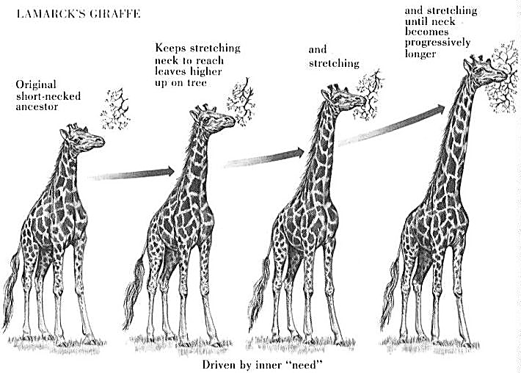
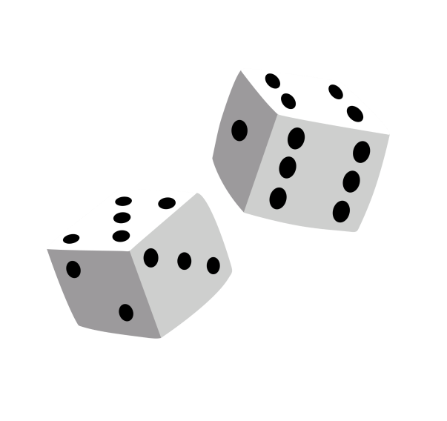
Background
Two key concepts
Natural variability – differences between individuals or groups (arising from genetic and/or environmental differences)
Uncertainty – lack of precise knowledge of characteristics, processes or events (arising from randomness in nature, or incomplete information)

Slide 4
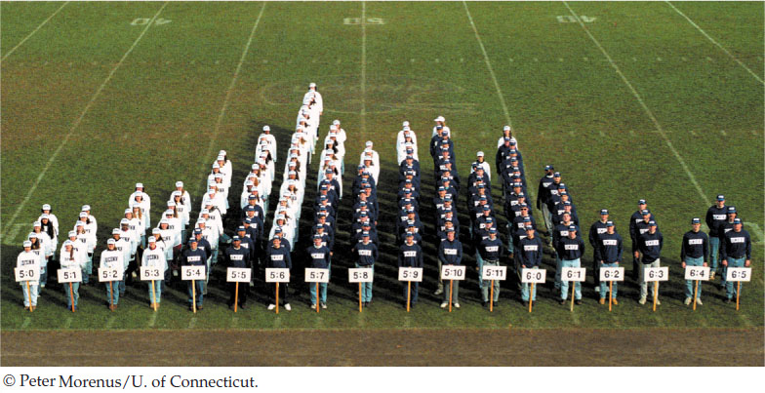
Background
Natural variability is a feature of the natural world, a quantity of interest that we wish to measure

Slide 5
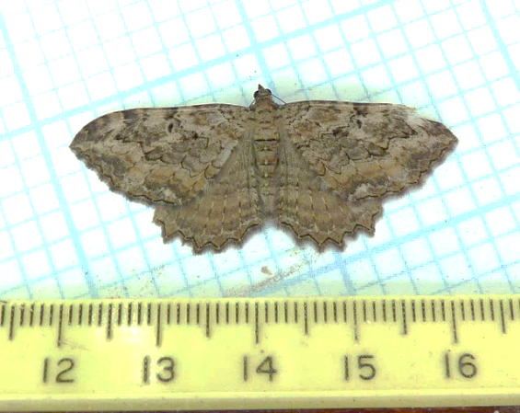

Background
Uncertainty is a nuisance that we wish to remove – however, observations (data) almost always have uncertainty, either because of
incomplete information or disagreement regarding a knowable true value (e.g., measurement error, missing data, etc.)
or,
inherent unpredictability of an unknowable true value (e.g., randomness, complexity, etc.)

Slide 6
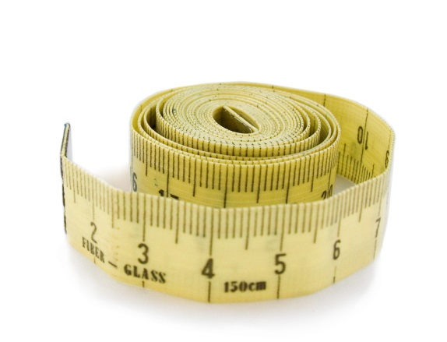
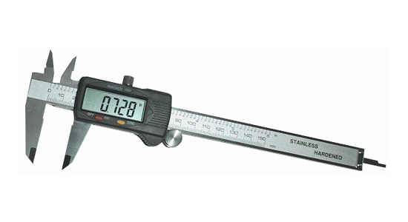
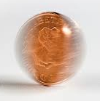
Background
Uncertainty can be reduced by collecting more and better information, but never entirely removed
there is always measurement error, even if very small
uncertainty due to randomness cannot be reduced

Slide 7


Populations and samples
Typically our goal is to understand health-related phenomena in a large group of individuals (population)
Two options are available:
observe/measure every individual in the population (rare)
use statistics to infer from samples to population (often)

Slide 8
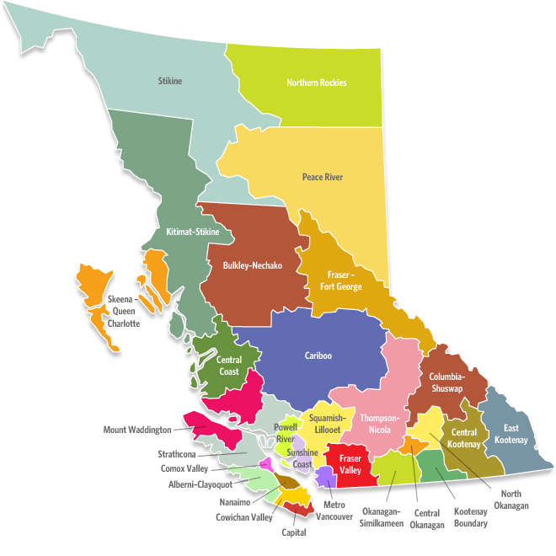
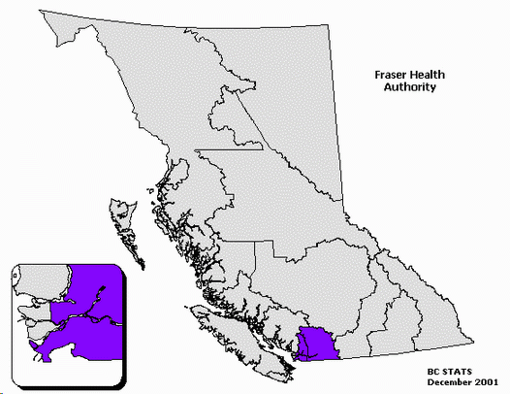

Populations and samples
A TARGET POPULATION
BC population = 4.8 million
A STUDY POPULATION (sampling frame)
FHA population = 1.7 million
A STUDY SAMPLE

Slide 9
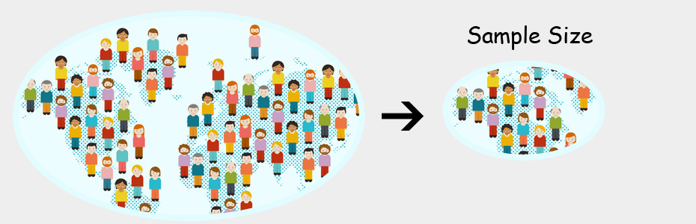

Populations and samples
Taking measurements from population samples has important implications for variability and uncertainty
Population
Sample

Slide 10
Populations and samples
Natural variability in a population can be estimated though representative samples and measures of variation
POPULATION
SAMPLE
Sample mean ± SD: 6.9 ± 1.8
Population mean ± SD: 6.2 ± 1.6

Slide 11
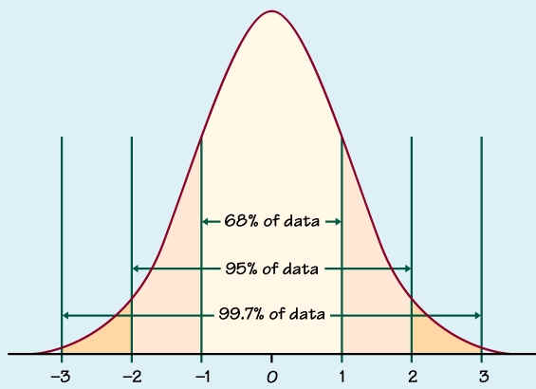
Measures of variation
Variance: how spread out data are in a sample (or in a population)
average squared deviation of data points from the mean
Standard deviation: spread of data around the mean in a sample (or a population)
square root of variance
For normally distributed data, mean and SD determine data intervals
Standard deviations from the mean

Slide 12
Measures of variation
Can we reduce natural variability in our data?
If we increase our sample size, does that change our measures of variation?
Sample mean ± SD: 6.9 ± 1.8
Sample mean ± SD: 7.1 ± 1.3
Sample mean ± SD: 6.5 ± 1.5
Population mean ± SD: 6.2 ± 1.6

Slide 13
Populations and samples
However, samples do not necessarily behave alike, or exactly like the population -- hence, we have sampling error and measures of uncertainty
POPULATION
50%
sample 1
sample 2
67%
sample 3
25%
Prevalence of = 44%

Slide 14
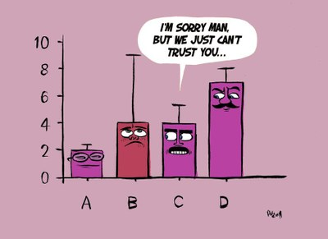
Measures of uncertainty
Repeatedly sampling a population generates a distribution of values (means, for example)
Standard error: the SD of this distribution; a measure of uncertainty or precision
Confidence intervals: interval of this distribution within which a sample statistic will fall (e.g., sample mean falls within this interval 95% of the time)

Slide 15
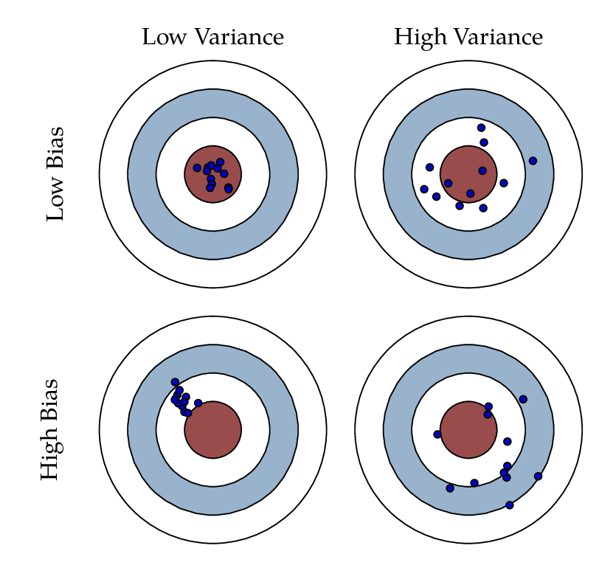
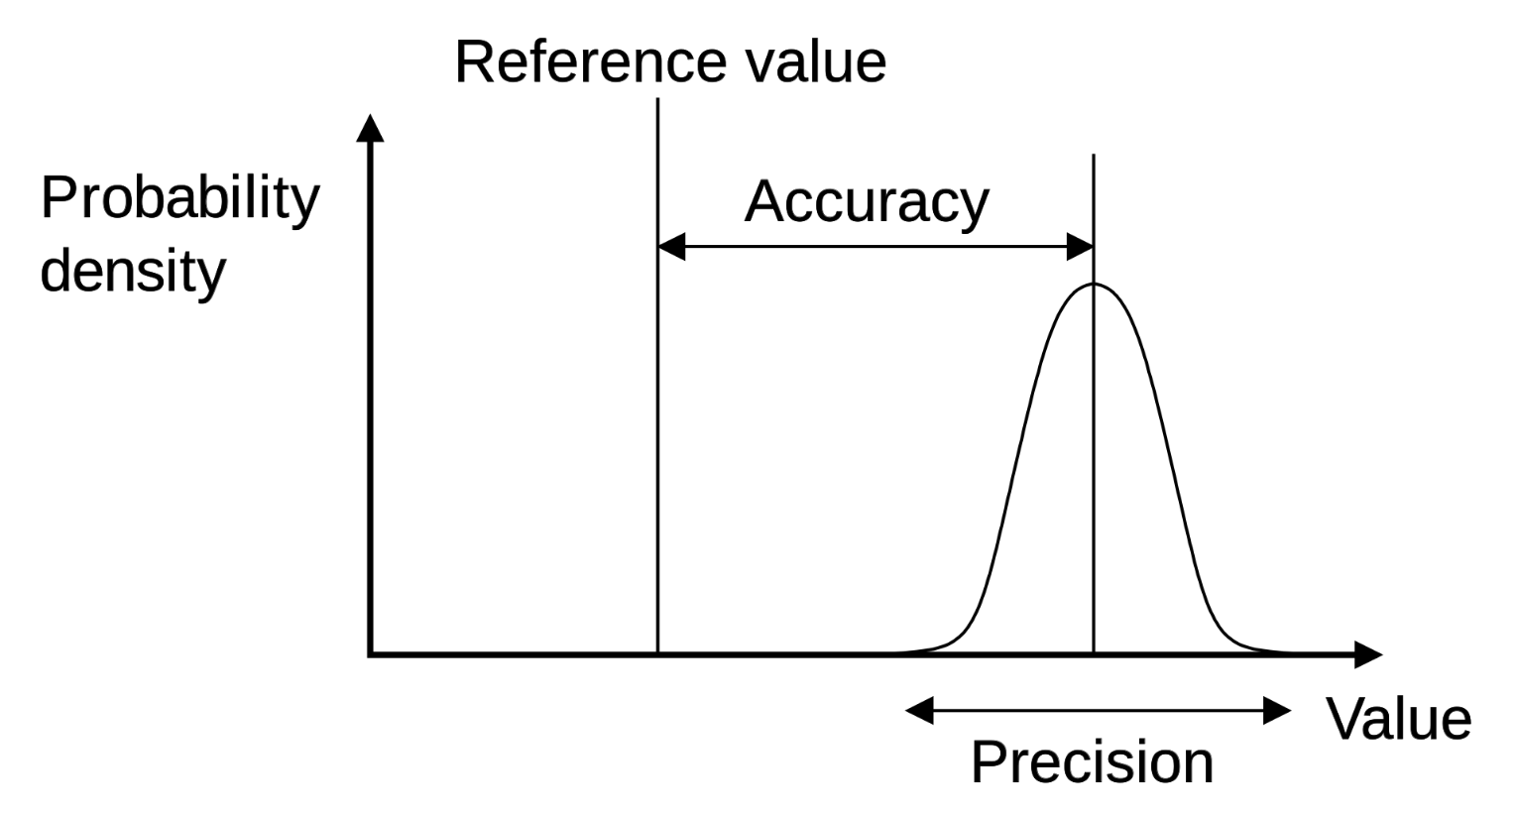
Measures of uncertainty
Note that measures of uncertainty reflect the precision of study results, not necessarily the accuracy
A poorly designed study could generate very precise estimates that are completely wrong
Actual value
Estimated value

Slide 16
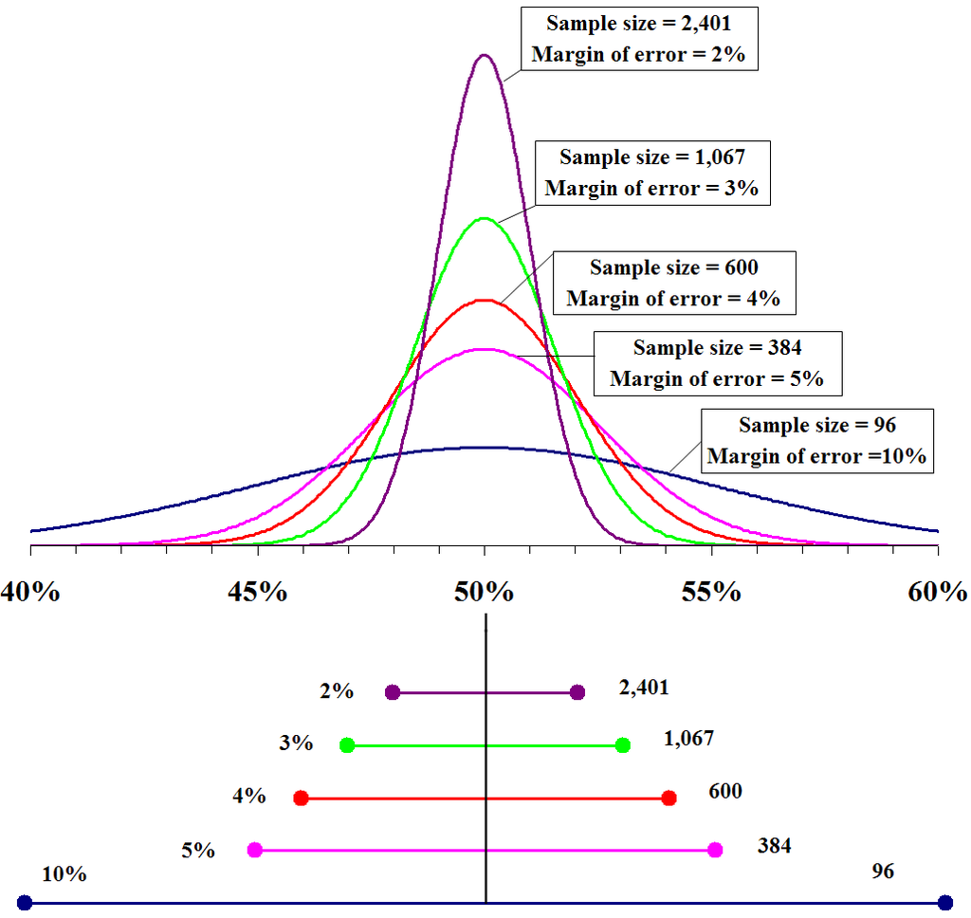
Measures of uncertainty
We can see how uncertainty is reduced when more information is collected
N = 2,401
Certainty that true (population) value is near observed (sample) value depends on sample size
In order to reduce sampling uncertainty (95% CI) by a factor of 2, we must increase sample size by a factor of 4
N = 1,067
N = 600
N = 384
N = 96
95% Confidence Intervals
https://en.wikipedia.org/wiki/Margin_of_error

Slide 17
Sources of uncertainty
True causal relation
Observed data
True values, sample
True values, population
Data generating process
- confounding
- sampling error
- selection bias
- measurement error
- missing data
Sources of uncertainty

Slide 18
General linear models
Recall that in general linear models, the error term (ε) captures so-called ‘unexplained variation’
intercept
predictor
response
slope
error
(‘residual’)
These errors (residuals) are assumed to be normally distributed

Slide 19

General linear models
Early linear regressions were used to study positions of astronomical bodies and variation was due to measurement error, for which the Normal distribution is appropriate
In later applications, particularly in biology, variation in measurements arose from both uncertainty and natural variability; hence, error term commonly includes any ‘unexplained variation’

Slide 20
Generalized linear models
Recall that in generalized linear models (e.g., Poisson regression), no error term is specified
y_{i} ~ Poisson(u_{i})
E(y_{i}|x_{i}) = log(µ_{i}) = α + βx_{i}
But that the expected variance around our observations y comes directly from the underlying distribution
For example, in Poisson regression variance of y_{i} should be equal to the mean µ_{i}
As with general linear models, the observed error can be a ‘catch all’ of uncertainty (randomness, measurement error) and natural variability

Slide 21
Summary
Two related concepts, natural variability and uncertainty, generate measureable variation in our data
some of this variation is interesting (differences between individuals), but some is a nuisance that may or may not be reducible
Samples are often used to study populations and this presents us with both natural variability and uncertainty
the two sources of variation have differing measures and interpretations
In statistical modeling using GLMs or GLIMs, observed variation is usually captured in a ‘catch all’ of both natural variability and uncertainty
Knowing there are multiple sources of variation helps in the understanding of these models and what is actually explained

